Slide 1

Data Mining Approach to Predict Campaign Result
With Bank Marketing Dataset
Chunyi Bi

Slide 2

Project Background (1/3) : Bank TeleMarketing
Campaigns
Call Center
Target Customer
A Portuguese retail bank uses marketing selling campaigns to enhance business. The bank uses call center to contact target customers and encourage them to subscribe a certain product.
Subscribe?

Slide 3
Project Background (2/3) : Project Goal
Main Goal
Propose data mining approaches to predict the success of telemarketing calls for selling long-term deposits
Could we
Help the bank to develop deeper understanding of the target customers and establish customer profile?
Increase the effectiveness of the bank's telemarketing campaign?

Slide 4
Project Background (3/3) : DATASET
Dataset is collected from 2008 to 2013, containing customer related data and campaign related data.
21 Attributes, 41,188 instances, and no missing value.
CATEGORY | # | ATTRIBUTES and DESCRIPTION |  | TYPE
Bank Client data | 1 | age | age of the customer | numeric
 | 2 | job | type of job | categorical
 | 3 | marital | marital status | categorical
 | 4 | education | education level | categorical
 | 5 | default | has credit in default? | binary
 | 6 | housing | has housing loan? | binary
 | 7 | loan | has personal loan? | binary
the most recent Contact Data | 8 | contact | contact communication type | categorical
 | 9 | month | last contact month of year | categorical
 | 10 | day_or_week | last contact day of week | categorical
 | 11 | duration | last contact duration, in seconds | numeric
Campaign Data | 12 | campaign | number of contacts performed during this campaign | numeric
 | 13 | pdays | number of days that passed by the most recent contact | numeric
 | 14 | previous | number of contacts performed before this campaign | numeric
 | 15 | poutcome | outcome of the previous marketing campaign | categorical
Social and Eco | 16-20 | emp.var.rate, cons.price.idx, cons.conf.idx, euribor3m, nr.employed |  | numeric
Target Output | 21 | y | has the client subscribed a term deposit? | binary

Slide 5
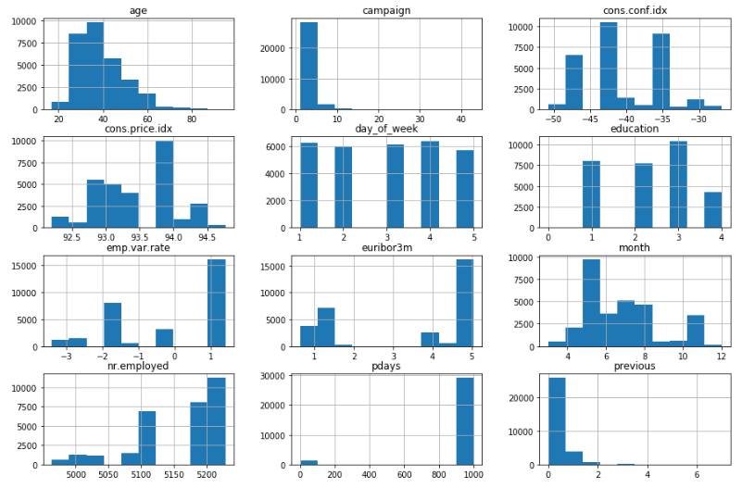
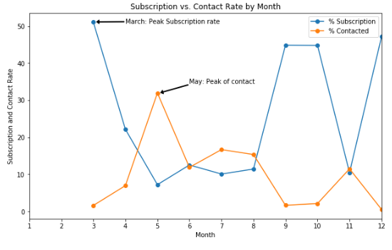
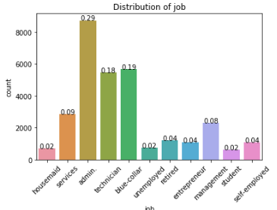
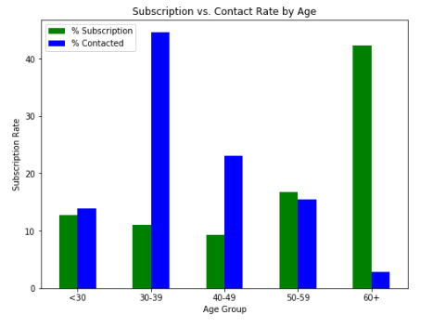
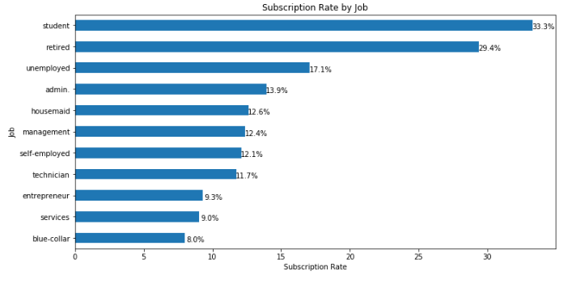
Visualization

Slide 6
Classification Model
DATA
Data Preprocessing:
missing value
duplicated rows
data transformation (one-hot encoding, label encoding)
SMOTE upsampling
Scale
Model Building:
Evaluation matrix: AUC score
Baseline model: Logistic Regression
Parameter Tuning: Logistic Regression/ KNN
Final model
Implementation
Preprocessing
EDA
Training
Validation
Data-driven Insights
Testing
Implementation
Evaluation
Model Construction

Slide 7

Managerial Conclusions
Goal: Propose data mining approaches to predict the success of telemarketing calls for selling long-term deposits
Insights
The bank should target the youngest and the oldest group, instead of middle-aged group.
The bank should target the students and retired customer group.
The bank should initiate campaign during spring and fall.
The bank should pay attention to the social and economic indicators.

Slide 8
THANK YOU

